Slide 1
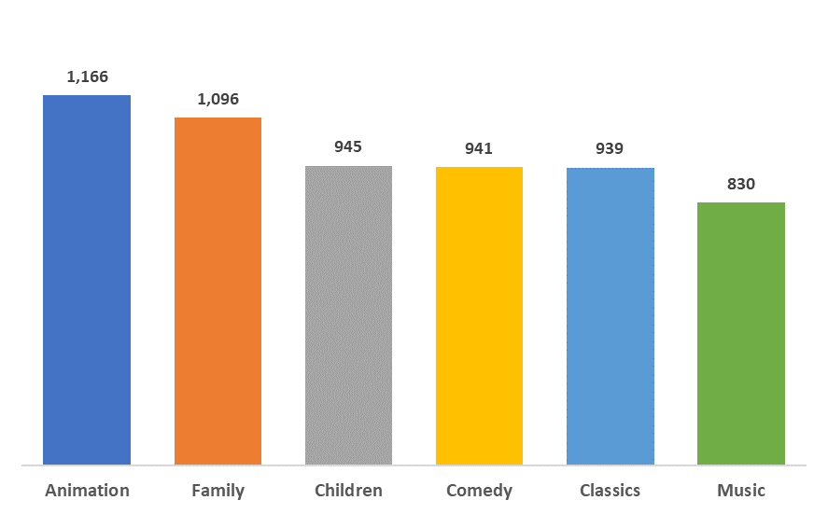
What were the total rental per Category?
The most popular movie category is Animation. While music category sounds like a fun category, it has the least number of rentals, among the categories considered family movies.
Notes:
/*Query used for Question Set #1 - Question #1*/
SELECT a.title AS FilmTitle,
c.name AS CategoryName,
Count(e.rental_id) AS Rentals
FROM film a
JOIN film_category b ON a.film_id = b.film_id
JOIN Category c ON b.category_id = c.category_id
JOIN Inventory d ON a.film_id = d.film_id
JOIN Rental e ON d.inventory_id = e.inventory_id
WHERE c.name IN ('Animation', 'Children', 'Classics', 'Comedy', 'Family', 'Music')
GROUP by a.title, c.name
ORDER BY 2,1 ASC , 3 DESC

Slide 2
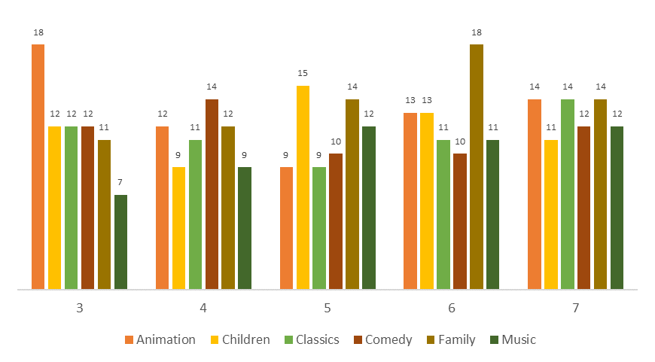
How many rental by duration for each film category?
Animation movies are most rented for 3 days rental duration, while Family movies are most rented for at 6 days duration.
Notes:
/*Query used for Question Set #1 - Question #3*/
SELECT CategoryName,
RentalDuration,
COUNT(CategoryName)
FROM (SELECT c.name AS CategoryName,a.rental_duration AS RentalDuration,
NTILE(4) OVER (ORDER BY a.rental_duration) AS Quartiles
FROM film a
JOIN film_category b ON a.film_id = b.film_id
JOIN category c ON c.category_id = b.category_id
WHERE c.name IN ('Animation', 'Children', 'Classics', 'Comedy', 'Family', 'Music')) F
GROUP BY 1, 2
ORDER BY 1, 2

Slide 3
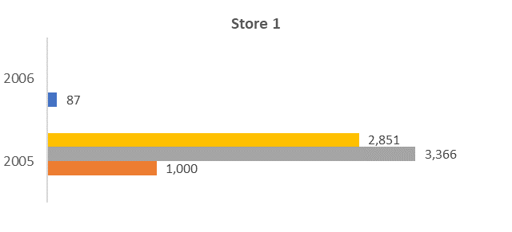
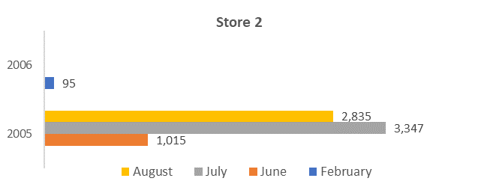
How the two stores compare in their count of rental orders?
<visualization>
The two stores had the same performed in both years, based on the number of rental by month.
Notes:
/*Query used for Question Set #2 - Question #1*/
SELECT DATE_PART('YEAR', a.rental_date) RentalYear,
DATE_PART('MONTH', a.rental_date) RentalMonth,
d.store_id,
COUNT(d.store_id)
FROM rental a
JOIN payment b ON b.rental_id = a.rental_id
JOIN staff c ON c.staff_id = b.staff_id
JOIN store d ON d.store_id = c.store_id
GROUP BY 1, 2, 3
ORDER BY 1 DESC, 2, 3, 4 DESC

Slide 4
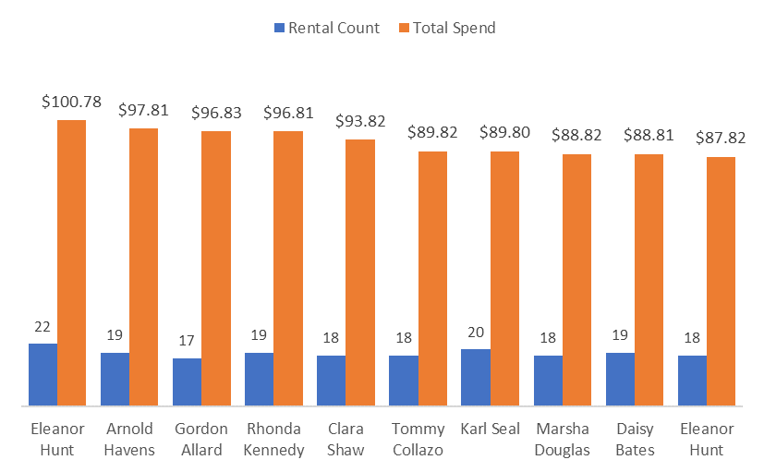
Who were our top 10 paying customers in 2007?
The top 10 customers spends $87.82 to as much as $100.78 in the year 2007.
Notes:
/*Query used for Question Set #2 - Question #2*/
SELECT DATE_PART('MONTH',b.payment_date) AS MonthPayment,
a.first_name||' '||a.last_name AS CustomerName,
COUNT(b.payment_id) AS CountPayment,
SUM(b.amount) AS TotalPayment
FROM customer a
JOIN payment b ON a.customer_id = b.customer_id
WHERE b.payment_date BETWEEN '2007-01-01' AND '2007-12-31'
GROUP BY 1,2
ORDER BY 4 DESC
LIMIT 10;

